Slide 1
Echoes of Ambition
By: Preslav Yordanov
Georgi Shahanov

Slide 2
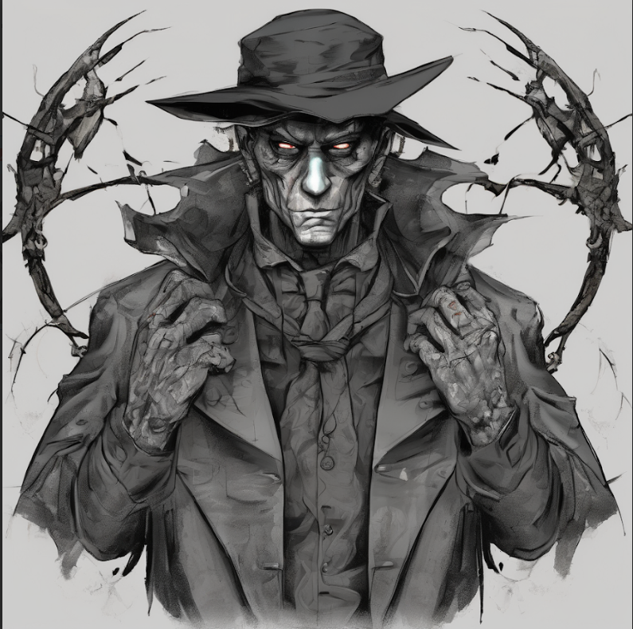
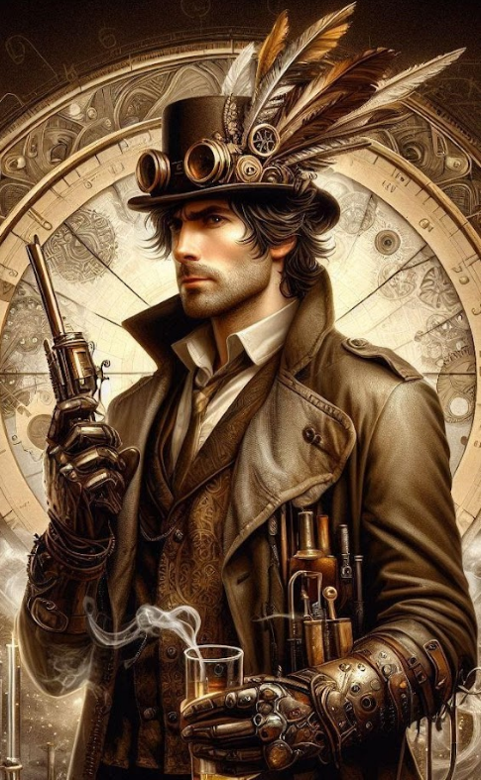
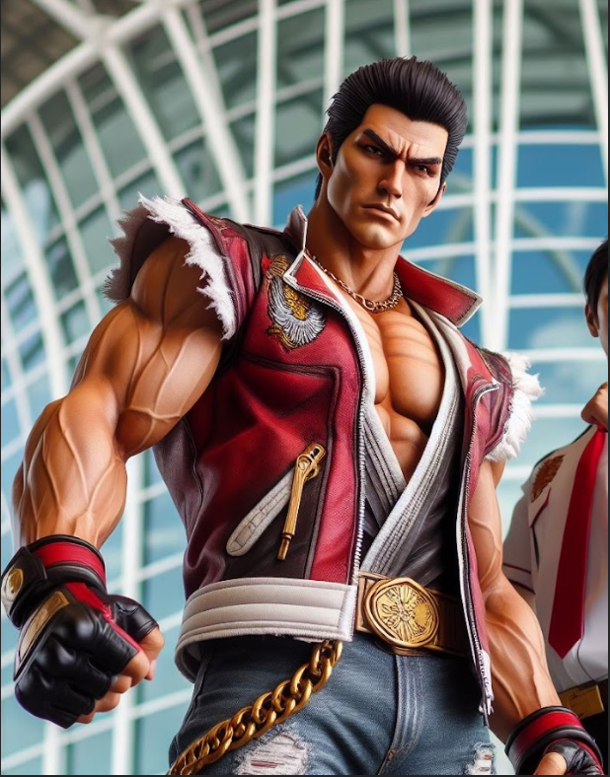
Characters
Maxwell Sterling
Darius Blackfang
Maxwell Sterling
Nathan Pierce

Slide 3
Darius Blackfang
Ambitious, Apathetic, Antisocial, Arrogant, Arrogant, Calculating, Callous, Charismatic, Charming, Cold-hearted, Cold, calculating gaze, Conceited, Condescending, Condescending, Confrontational, Conniving, Cruel, Cunning, Cynical, Dark and foreboding attire, Deceptive, Determined, Devious, Disfigurements, Disloyal, Dismissive, Dominant, Dominant posture, Dominating, Egoistic, Egotistical, Envious, Exploitative, Fearless, Greedy, Hedonistic, Imposing physique, Impatient, Impulsive, Inhumane, Invasive, Insensitive, Insidious, Intimidating presence, Intolerant, Irresponsible, Irrational, Manipulative, Manipulative, Materialistic, Mercenary, Merciless, Menacing stature, Narcissistic, Obsessive, Opportunistic, Paranoid, Paranoid, Pessimistic, Pompous, Power-hungry, Proud, Rational, Relentless, Reckless, Relentless, Ruthless, Ruthlessness, Sadistic, Sadistic, Scars or, Scheming, Sharp and predatory movements, Sinister smile, Sensitive, Scheming, Self-confident, Sensitive, Sharp and predatory movements, Sincere, Spectacled, Statuesque, Stoic, Strategic, Strong, Stubborn, Successful, Tall, Tireless, Tough, Treacherous, Trustworthy, Trustworthy, Two-faced, Unapologetic, Unemotional, Unethical, Unforgiving, Unscrupulous, Unselfish, Untrustworthy, Vengeful, Well-groomed, Wise.

Slide 4
Maxwell Sterling
2nd. Maxwell Sterling
Adaptable, Adventurous, Agile, Amused, Appreciative, Attractive, Bright, Calm, Careful, Caring, Charismatic, Charming, Clean-shaven, Clever, Communicative, Compassionate, Cooperative, Courageous, Creative, Curious, Energetic, Encouraging, Enthusiastic, Excited, Excellent shooter,, Fair, Flexible, Forgiving, Friendly, Funny, Generous, Happy, Hopeful, Honest, Humorous, Imaginative, Impatient, Impulsive, Joyful, Kind, Kind-hearted, Knowledgeable, Lovable, Loving, Merciful, Nonchalant, Nonjudgmental, Observant, Observant, Open-minded, Optimistic, Positive, Reliable, Relaxed, Selfless, Simple, Simple-minded, Smiling, Supportive, Sympathetic, Tall, Thankful, Tireless, Tough, Trusting, Trustworthy.

Slide 5
Nathan Pierce
3rd. Nathan Pierce
Adaptable, Adventurous, Ambitious, Analytical, Angry, Attractive, Athletic, Brave, Broad-shouldered, Bulky, Charismatic, Clever, Cold-hearted, Committed, Confident, Courageous, Decisive, Determined, Disciplined, Eager, Fearless, Fearless, Fighter, Fit, Handsome, Hard-working, Heavyset, Honest, Humble, Impulsive, Independent, Independent, Intelligent, Intuitive, Leader, Logical, Logical, Loyal, Mature, Methodical, Muscular, Observant, Patient, Persistent, Principled, Proud, Quiet, Rational, Rational, Reliable, Resilient, Respectful, Self-confident, Sensitive, Sincere, Spectacled, Statuesque, Stoic, Strategic, Strong, Sturdy, Successful, Tall, Tireless, Tough, Trustworthy, Trustworthy, Unselfish, Well-groomed, Wise.

Slide 6
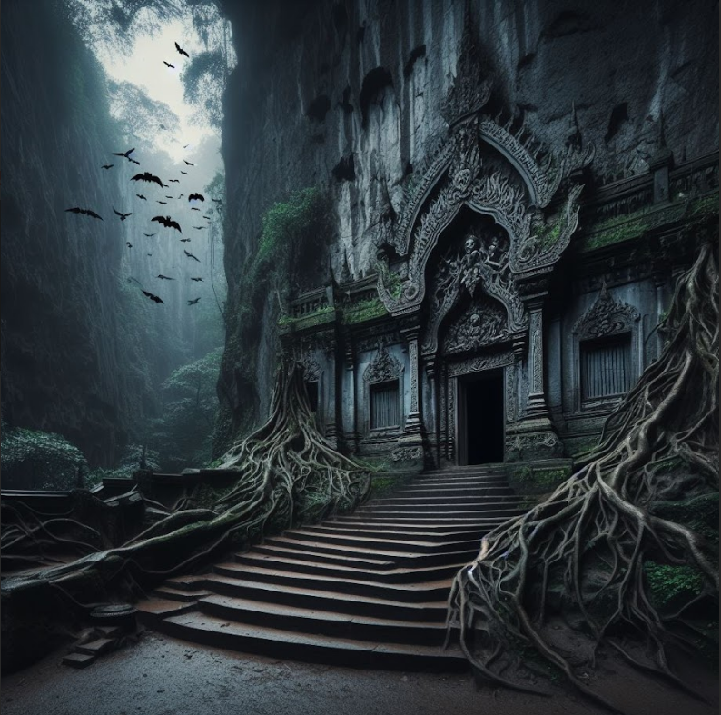
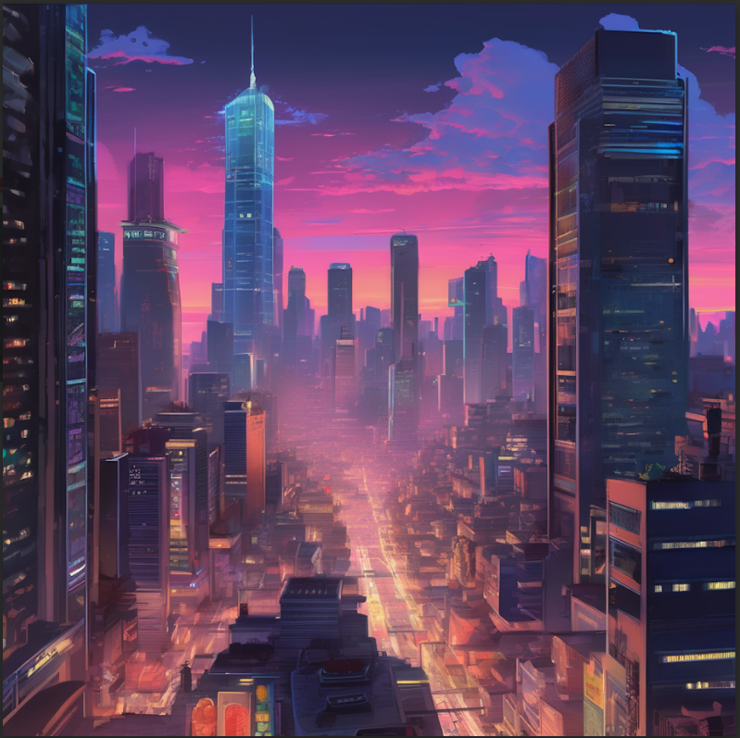
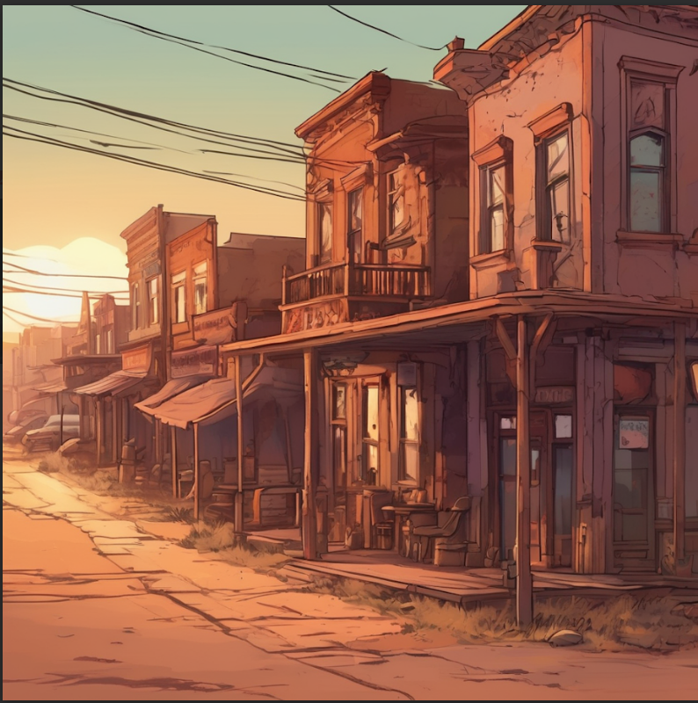
Locations
Evergreen Hollow
NeoVerse City
Sharpshot

Slide 7
Evergreen Hollow
Deep within the dense, ancient forests of the Pacific Northwest lies an abandoned logging town known as Evergreen Hollow. Surrounded by towering trees that seem to whisper secrets of the past, the town exudes an eerie atmosphere, with crumbling buildings swallowed by nature's relentless embrace. The air is thick with the scent of pine and damp earth, and the only sounds are the rustle of leaves and the occasional creaking of aged timbers. Yet, beneath the surface tranquility, there's an undeniable sense of unease, as if the very land holds dark secrets waiting to be unearthed. At the heart of Evergreen Hollow stands an imposing structure: the derelict Evergreen Temple. Once a fascinating temple belonging to the ancient people of Evergreen, nowadays it is a haunted place with secrets inside of it.

Slide 8
NeoVerse City
NeoVerse City, a bustling metropolis where skyscrapers reach for the clouds and neon lights paint the streets in a mesmerizing glow.

Slide 9
Sharpshot
The quaint town of Sharpshot, known for its dusty streets and sunsets that painted the horizon in warm hues. The rhythmic echoes of revolver shots resonated through the town.

